Slide 1
Clearance
Short Dated Items
This cart only
Clearance
Out of Date Items
This cart only

Slide 2
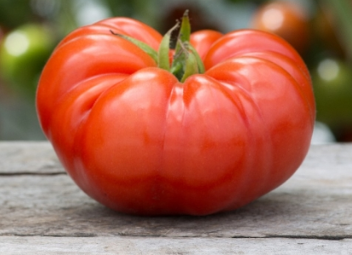
Colorado Grown
Beef Steak Tomatoes
$
2.59
Lb.
Colorado Grown
Beef Steak Tomatoes
$
2.59
Lb.

Slide 3
Short Dated
The Popcorn Cannery
Priced as Marked
Short Dated
The Popcorn Cannery
Priced as Marked

Slide 4
Our Bread has expanded!
Check around the corner for more items.
Organic and Specialty Breads have moved. Check around the corner for more options.

Slide 5
Shortened Hours
Farmers Fresh Market will be open from
9am – 6pm
Monday, September 2nd for Labor Day
Shortened Hours
Farmers Fresh Market will be open from
9am – 6pm
Monday, September 2nd for Labor Day

Slide 6
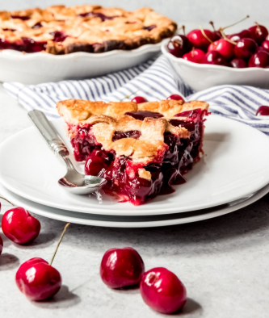
Pie Cherries
7lbs. Pitted Cherries
in Juice
$
27.99
Pie Cherries
7lbs. Pitted Cherries
in Juice
$
27.99

Slide 7
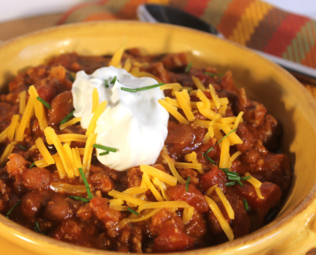
Short Dated- Manager’s Special!
SF Sour Cream
24 oz
$
2.69
Short Dated- Manager’s Special!
SF Sour Cream
24 oz
$
2.69

Slide 8
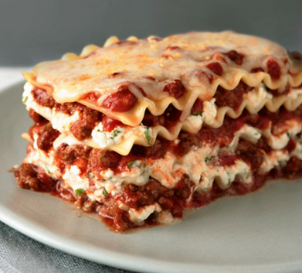
MANAGER’S SPECIAL
@ease Lasagna
Family Size
$
8
99
Del Monte Fruit Naturals
Great Summer Time Snack or Back to School!
All Varieties
¢
.75

Slide 9
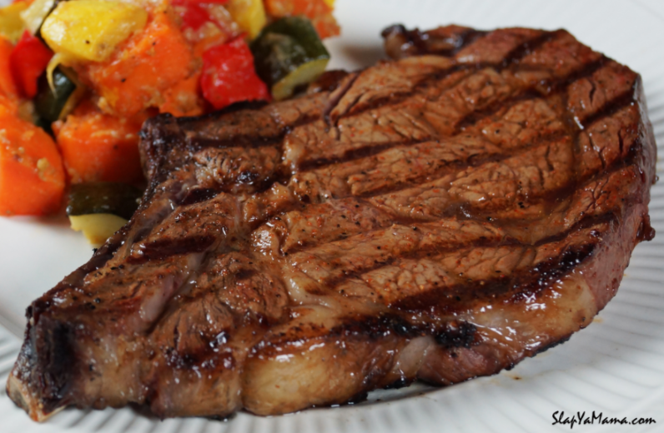
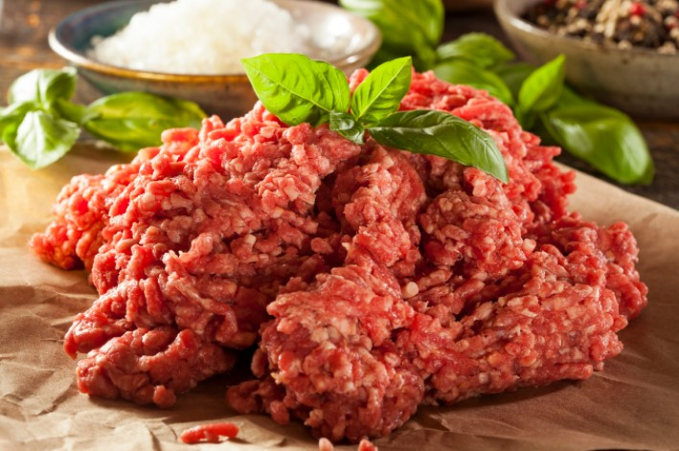
Rib Steak
Family Pack
$
7.99
lb.
Fresh Local Grass Fed Beef
$
4.29
lb.

Slide 10
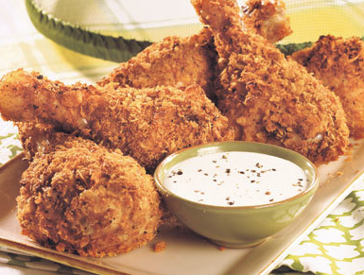
Fryer Drumsticks
Family Pack
.99
¢
lb.
Fryer Drumsticks
Family Pack
.99
¢
lb.

Slide 11
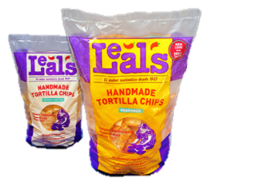
Leal’s Tortilla Chips
$3.49
Leal’s Tortilla Chips
$3.49

Slide 12
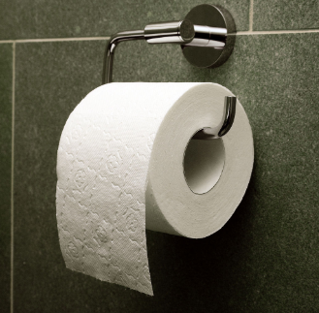
Clearance
Valu Time
Bathroom Tissue
4 Rolls
.89
¢
Clearance
Valu Time
Bathroom Tissue
12 Double Rolls
$
4.79

Slide 13
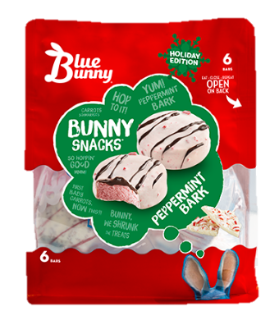
Blue Bunny Peppermint Bark Bunny Snacks
$3.99
Blue Bunny Peppermint Bark Bunny Snacks
$3.99

Slide 14
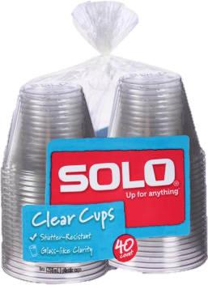
Solo Clear Cups
9oz. – 40ct.
$3.69
Solo Clear Cups
9oz. – 40ct.
$3.69
$3.69

Slide 15
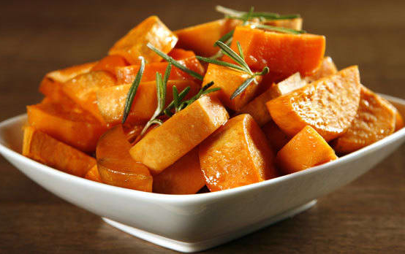
Christmas Wrapping
Paper
2
$
19
SF Cut Yams
15 Oz Can
1
2
$
FOR

Slide 16
Traction Ice Melt
20# Bag
50# Bag
$6.29
$13.69
Traction Ice Melt
20# Bag
50# Bag
$6.29
$13.69

Slide 17
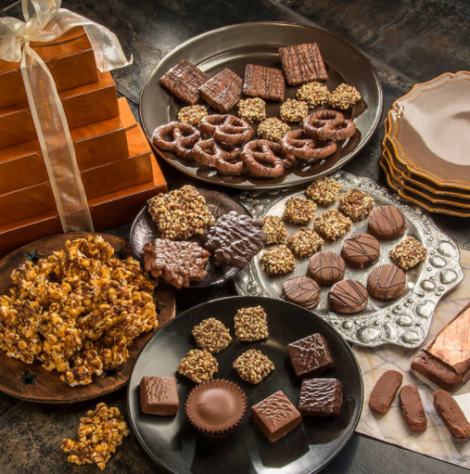
JJ’s Fried Pies
Assorted Flavors
.89¢
Rocky Mountain Chocolate Factory Chocolates
$5.49

Slide 18
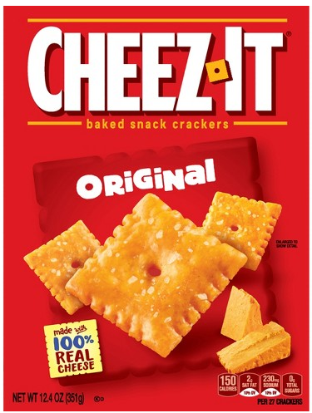
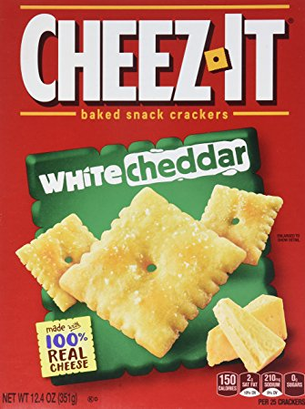
Cheez-It Crackers
Original, White Cheddar or
White Cheddar Grooves
$3.29
Cheez-It Crackers
Original, White Cheddar or
White Cheddar Grooves
$3.29

Slide 19
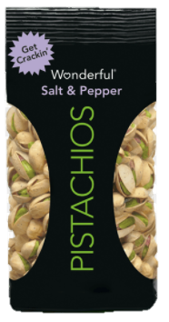
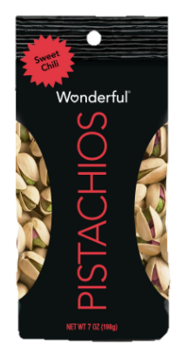
Wonderful Pistachios Salt & Pepper or Sweet Chili
$5.29
Wonderful Pistachios Salt & Pepper or Sweet Chili
$5.29

Slide 20
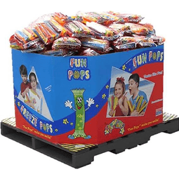
Fun Pops
$1.99
Fun Pops
$1.99

Slide 21
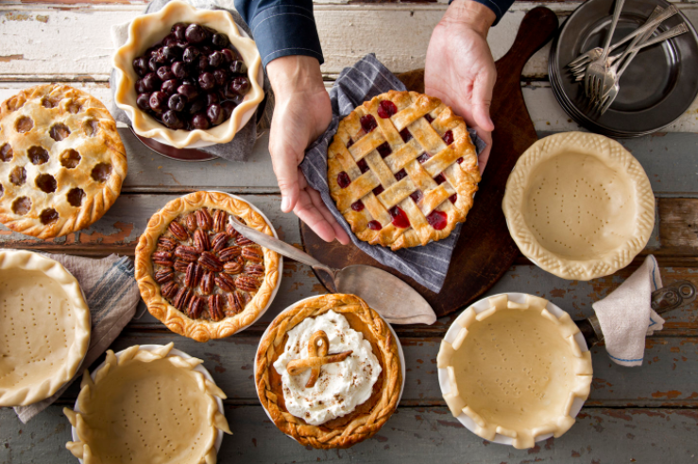
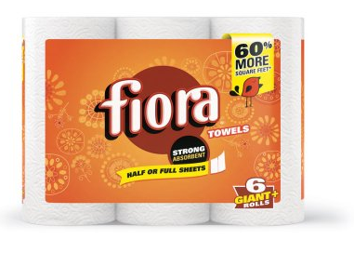
Sara Lee Pies
$1.99
Fiora Paper Towels
6 Rolls
$
4.59

Slide 22
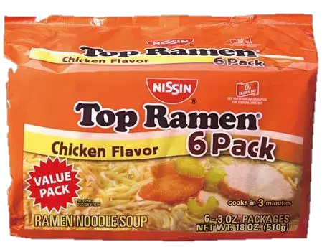
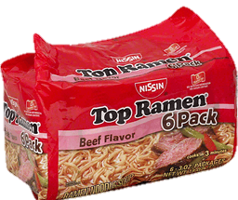
Top Ramen
6 Packs
2 for $4
Top Ramen
6 Packs
2 for $4

Slide 23
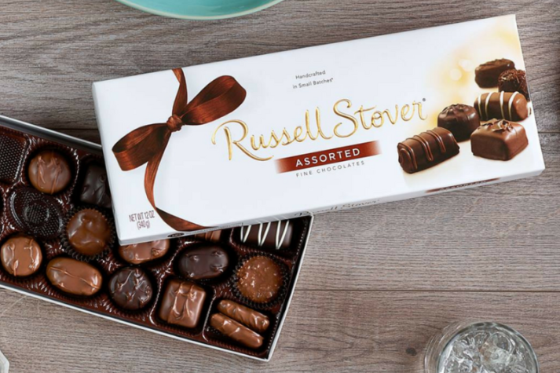
Russell Stover
Large Boxed Chocolates
$7.99
Russell Stover
Large Boxed Chocolates
$7.99

Slide 24
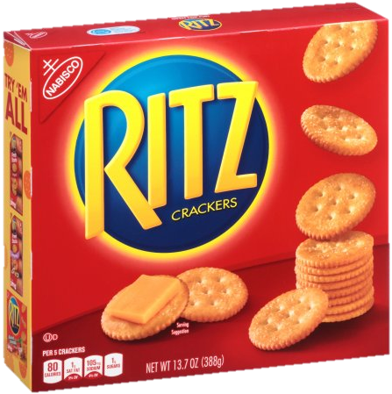
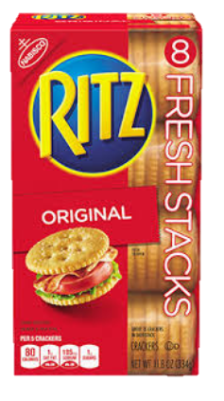
Ritz Crackers Original Boxed or Fresh Stacks
$4.49
Ritz Crackers Original Boxed or Fresh Stacks
$4.49

Slide 25
Big Foot Snow Shovel
$14.99
Big Foot Snow Shovel
$14.99

Slide 26
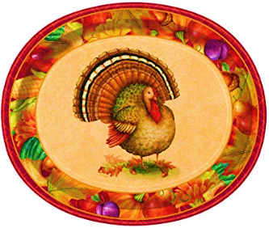
Festive Turkey Disposable Thanksgiving Dinner Ware
Napkins
Plates
16 ct.
8 ct.
$1.49
$2.99
Big Foot Snow Shovel
$14.99

Slide 27
Out of Date
75% OFF
This cart only
Out of Date
75% OFF
This cart only

Slide 28
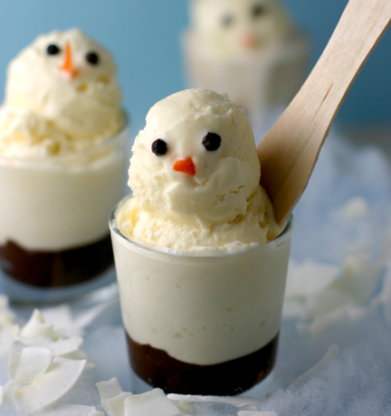
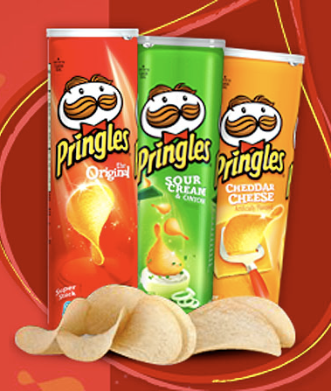
SF Vanilla Ice Cream
$2.59
Pringles Potato Chips
$2.19

Slide 29
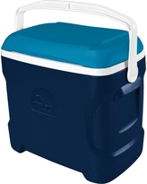
Igloo Contour
30 qt. Cooler
$29.99
Igloo Contour
30 qt. Cooler
$29.99

Slide 30
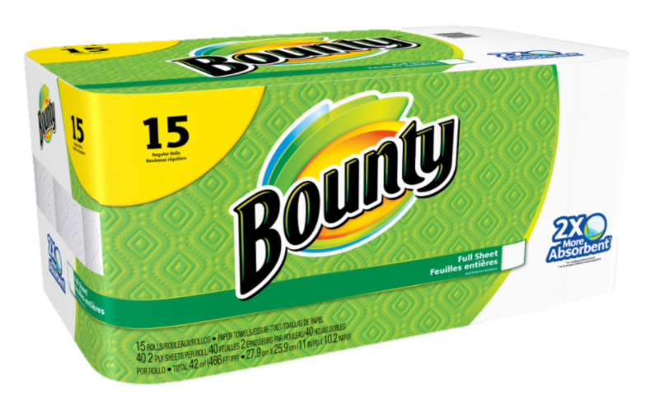
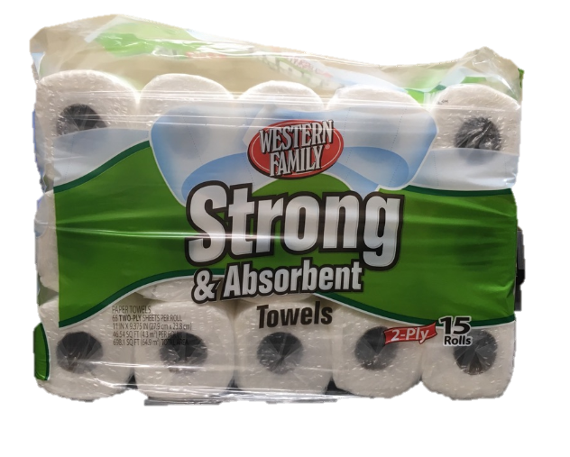
Bounty Paper Towels
15 Rolls
$21.99
Western Family Paper Towels
15 Rolls
$10.99

Slide 31
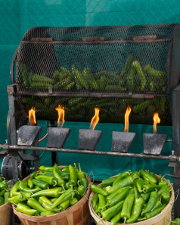
X-Hot
Roasted
Green Chiles
$2.99
Med
Roasted
Green Chiles
$1.99

Slide 32
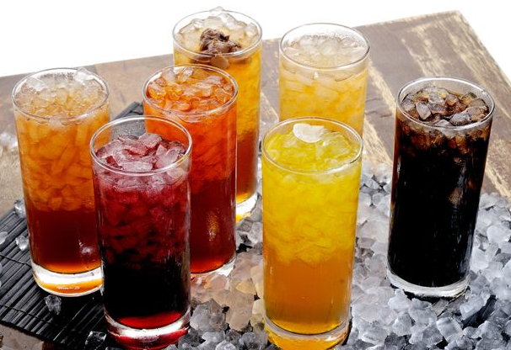
Shurfine Soda
3 Liter
4 $5
For
Shurfine Soda
3 Liter
4 $5
For

Slide 33
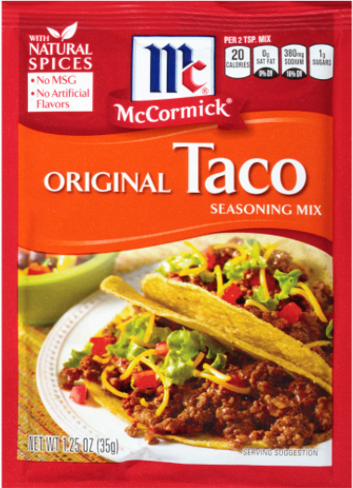
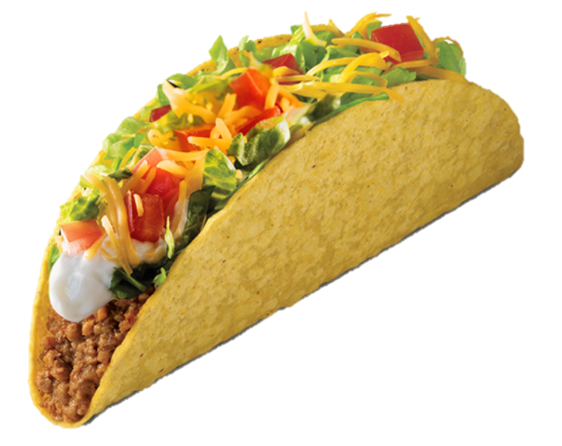
McCormick Original Taco Mix
2 for $1
McCormick Original Taco Mix
2 for $1

Slide 34
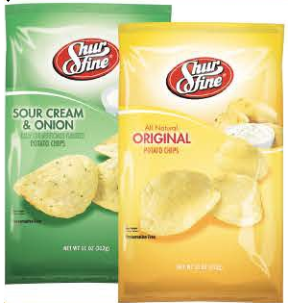
SHURFINE POTATO CHIPS
ASSORTED VARIETIES
2 FOR $4
SHURFINE POTATO CHIPS
ASSORTED VARIETIES
2 FOR $4

Slide 35
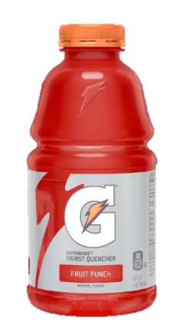
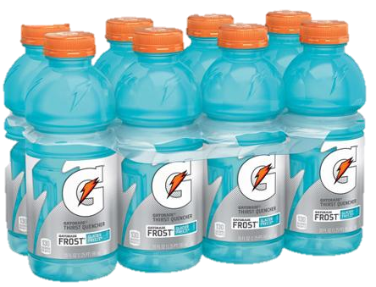
Gatorade
32 OZ
2 for $3
Gatorade
8 pack
$8.89

Slide 36
CHECK OUT THE SAVINGS!
ITEMS PRICED
AS MARKED
CHECK OUT THE SAVINGS!
ITEMS PRICED
AS MARKED

Slide 37
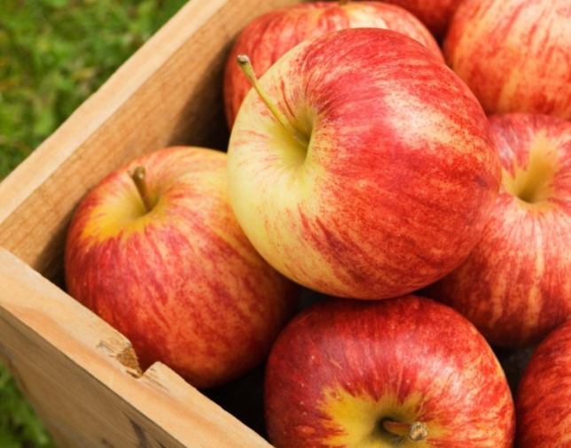
Colorado
Grown
Gala Apples
$1.49 lb
Colorado
Grown
Gala Apples
$1.49 lb

Slide 38
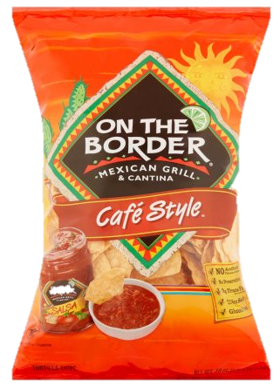
On The Border Tortilla Chips
12 oz
$2.69
On The Border Tortilla Chips
12 oz
$2.69

Slide 39
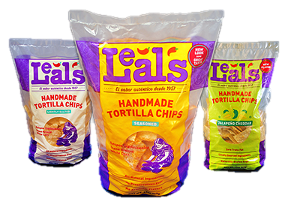
Leal’s Tortilla Chips
Assorted – 12 oz
$2.99
Leal’s Tortilla Chips
Assorted – 12 oz
$2.99

Slide 40
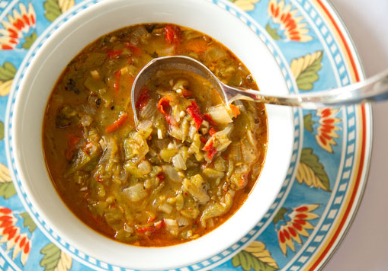
Tuesday Special
Award Winning Green Chile
12oz Bowl of Green Chile served with 2 warm Tortillas
$4.99
Tuesday Special
Award Winning Green Chile
12oz Bowl of Green Chile served with 2 warm Tortillas
$4.99

Slide 41
Tuesday Special
Award Winning Green Chile
12oz Bowl of Green Chile served with 2 warm Tortillas
$4.99
Tuesday Special
Award Winning Green Chile
12oz Bowl of Green Chile served with 2 warm Tortillas
$4.99

Slide 42
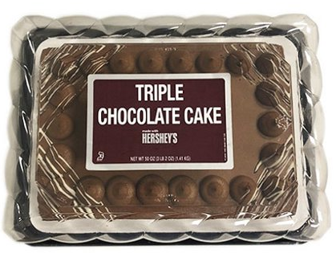
Hershey Triple Chocolate Cake
¼ Sheet
$24.99
Tuesday Special
Award Winning Green Chile
12oz Bowl of Green Chile served with 2 warm Tortillas
$4.99

Slide 43
Assorted Sunglasses & Safety Glasses
Priced as Marked
Assorted Sunglasses & Safety Glasses
Priced as Marked

Slide 44
Please check the ‘Sell By Date’ before slicing meat or cheese for customers!
¡Verifique la fecha de venta antes de cortar carne o queso para los clientes!
Please check the ‘Sell By Date’ before slicing meat or cheese for customers!
¡Verifique la fecha de venta antes de cortar carne o queso para los clientes!

Slide 45
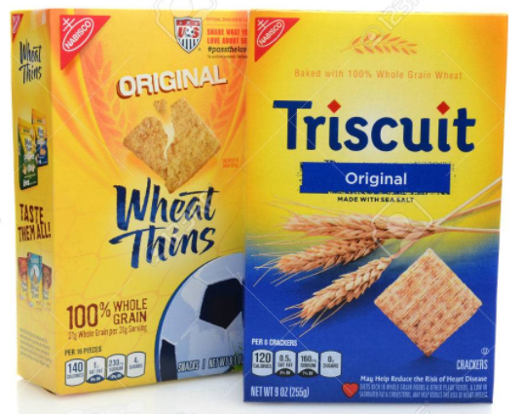
Triscuits or Wheat Thins
Assorted Flavors
$4.09
Triscuits or Wheat Thins
Assorted Flavors
$4.09

Slide 46
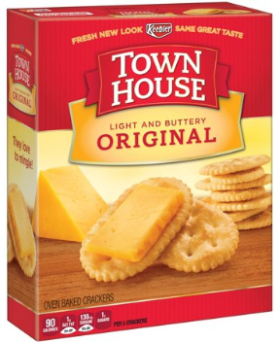
Town House Crackers
Assorted Varieties
$4.39
Town House Crackers
Assorted Varieties
$4.39

Slide 47
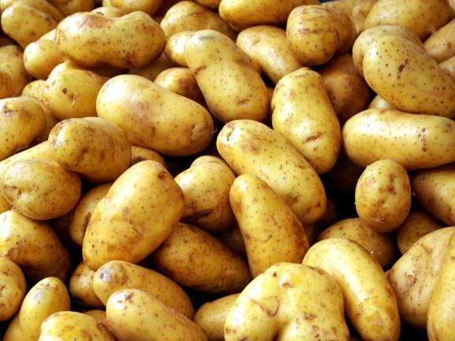
RUSSET POTATOES
10 LB BAG
$4.39 EA
RUSSET POTATOES
10 LB BAG
$4.39 EA

Slide 48
What a
Steal of a Deal!
Cranberry Bubly 12pk
2 for $5

Slide 49
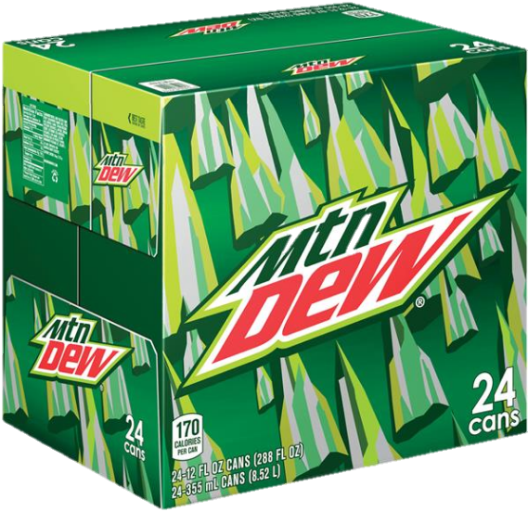
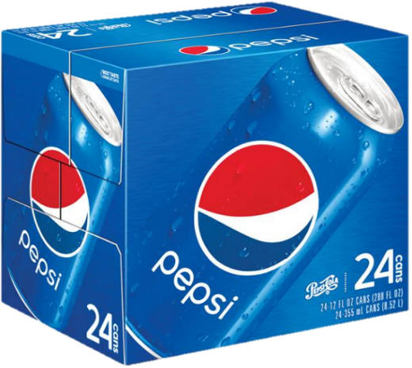
Pepsi Case
24 Pack
$8.99

Slide 50
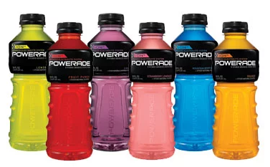
Powerade
$1.49

Slide 51
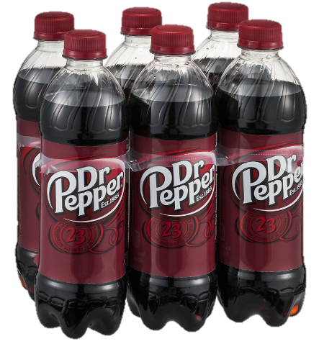
Pepsi
6 pk. – 16.9 oz.
$
4 / 10
Pepsi
6 pk. – 16.9 oz.
$
4 / 10

Slide 52
Coca-Cola 12 Packs
$5.49

Slide 53
Aquafina Water
$5.99

Slide 54
All Pepsi 12 Packs
$5.49

